Slide 1


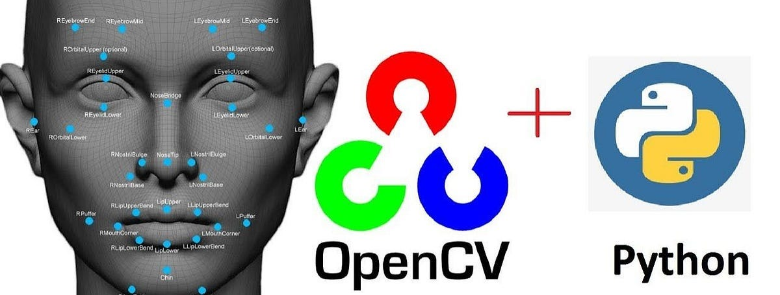
Session 12 :
SmartVision Analyzer
with Real-Time Webcam Processing

Slide 2
Project Overview
The SmartVision Analyzer is a project to implement OpenCV functions which includes real-time webcam processing, allowing users to apply all 10 image processing techniques live from their camera feed.
This makes the project more interactive and practical for real-world applications like surveillance, augmented reality, and interactive art.

Slide 3
Significant Features
✅ Live video capture & processing ✅ Toggle between different filters/techniques in real-time ✅ Performance optimization for smooth video processing ✅ On-screen display of active processing mode

Slide 4
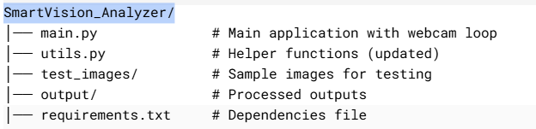
Python Code:
SmartVision Analyzer
1. Modified Project Structure

Slide 5
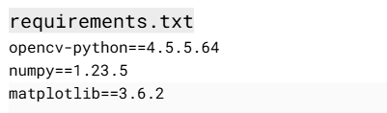
Implementation Steps
2. Updated Dependencies (requirements.txt)

Slide 6
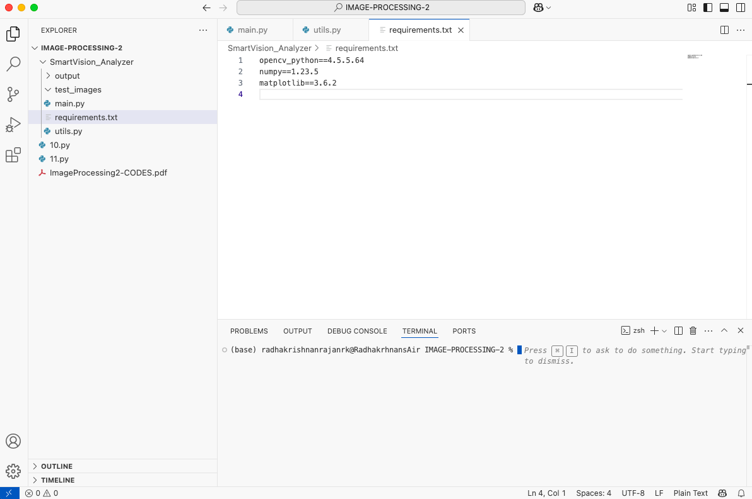
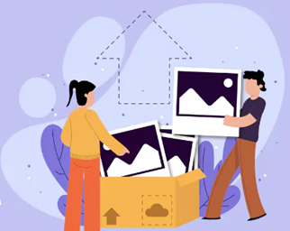

Slide 7
Implementation Steps
3. Features utils.py ( Real-Time Functions)
# --------------------------
# 1. Advanced Transformations
# 2. Thresholding & Segmentation
# 3. Edge Detection
# 4. Contour Detection
# 5. Shape Detection
# 6. Histogram Analysis
# 7. Motion Detection
# 8. Face Detection
# 9. Object Tracking (Color-based)
# 10. Artistic Filters
# --------------------------

Slide 8
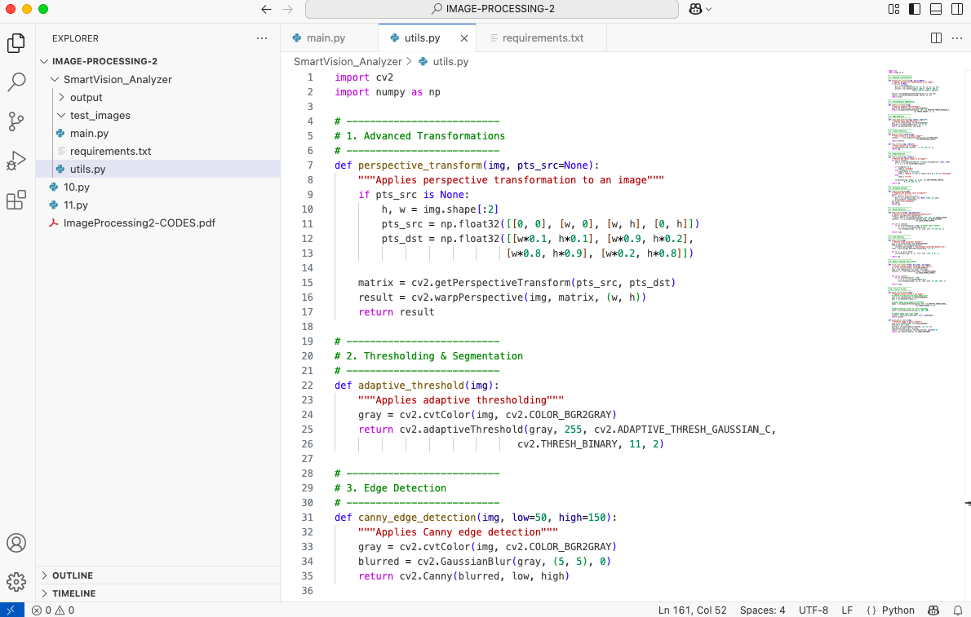

Slide 9
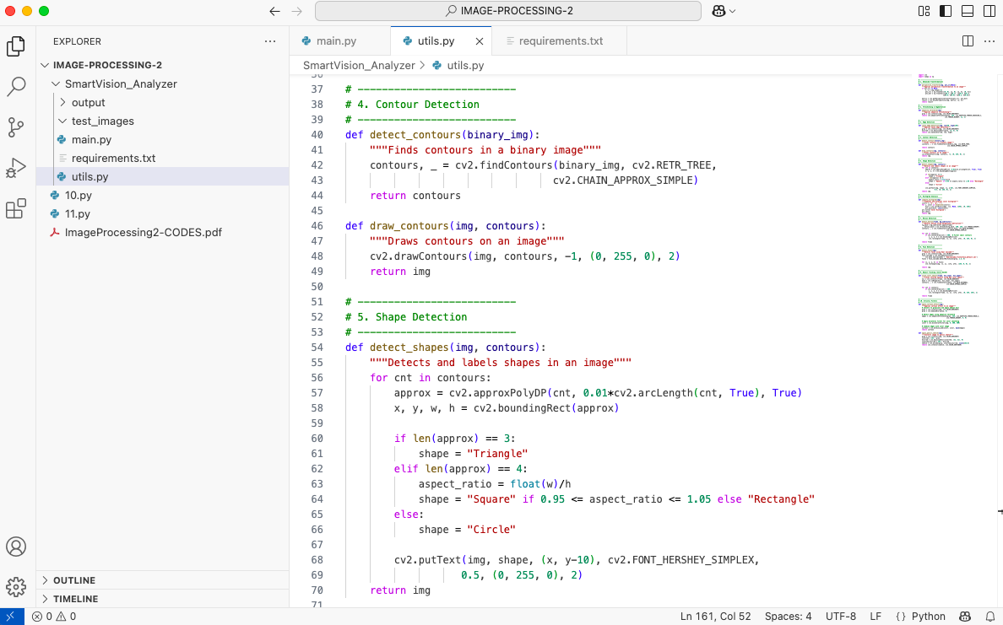

Slide 10
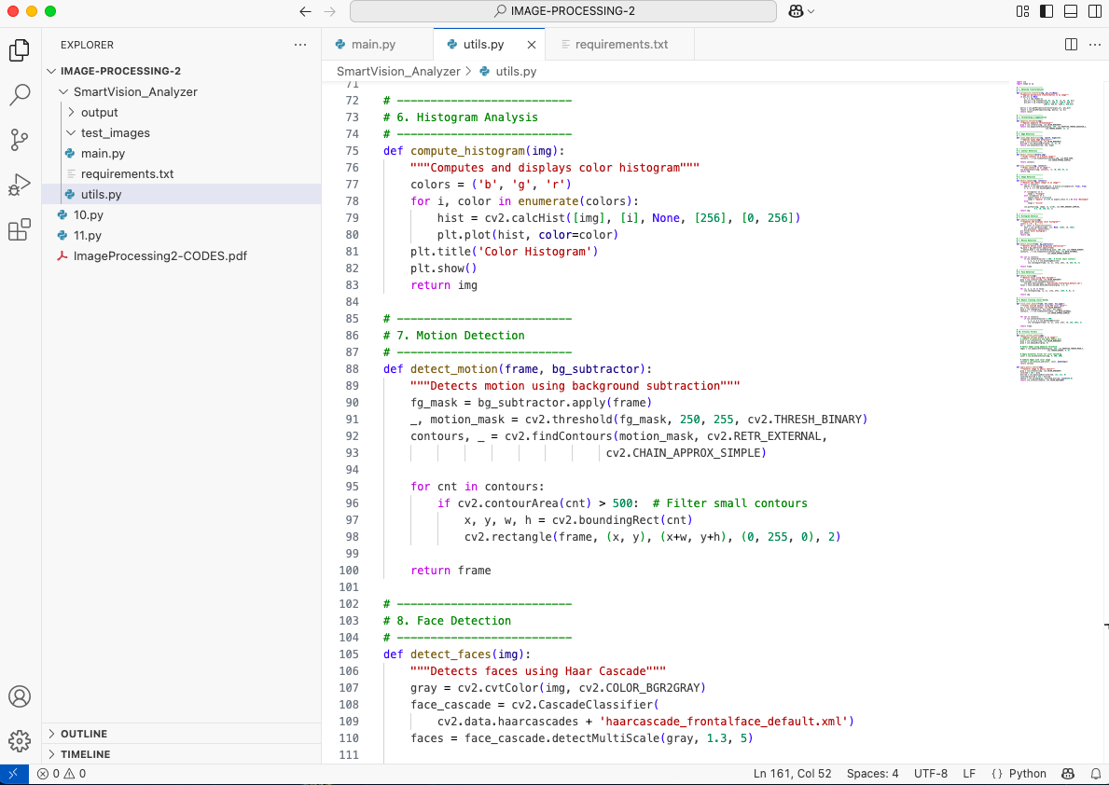

Slide 11
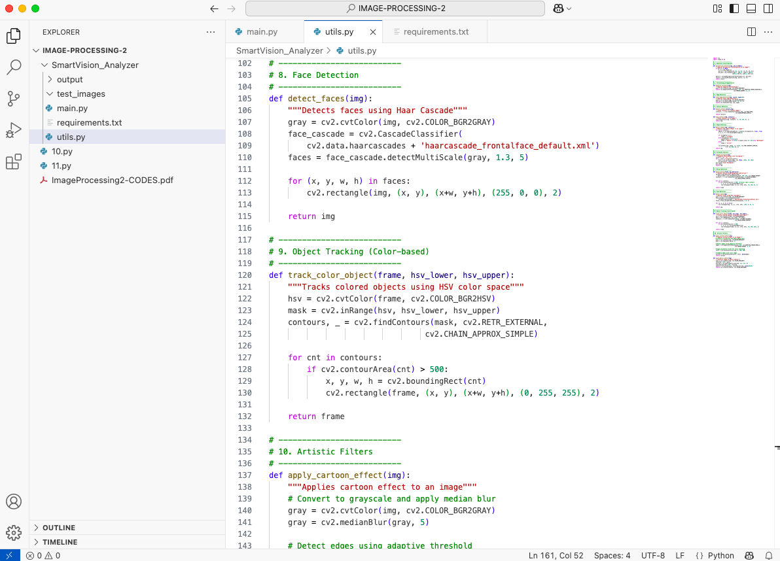

Slide 12
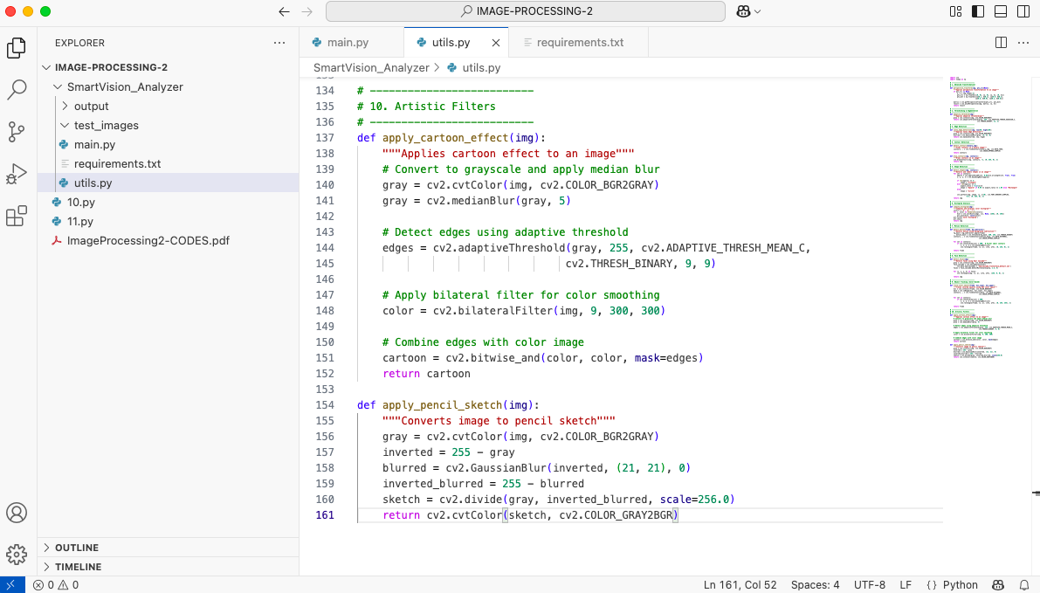

Slide 13
Implementation Steps
4. Features main.py ( Real-Time Functions)
# --------------------------
# 1) Initialize webcam
# 2) Set webcam resolution
# 3) Initialize background subtractor for motion detection
# 4) Available processing modes
# 4.1) Flip frame horizontally for mirror effect
# 4.2) Get current mode
# 4.3) Process frame based on selected mode
# 4.4) Display active mode and instructions
# 4.5) Show processed frame
# 4.6) Key controls
# --------------------------

Slide 14
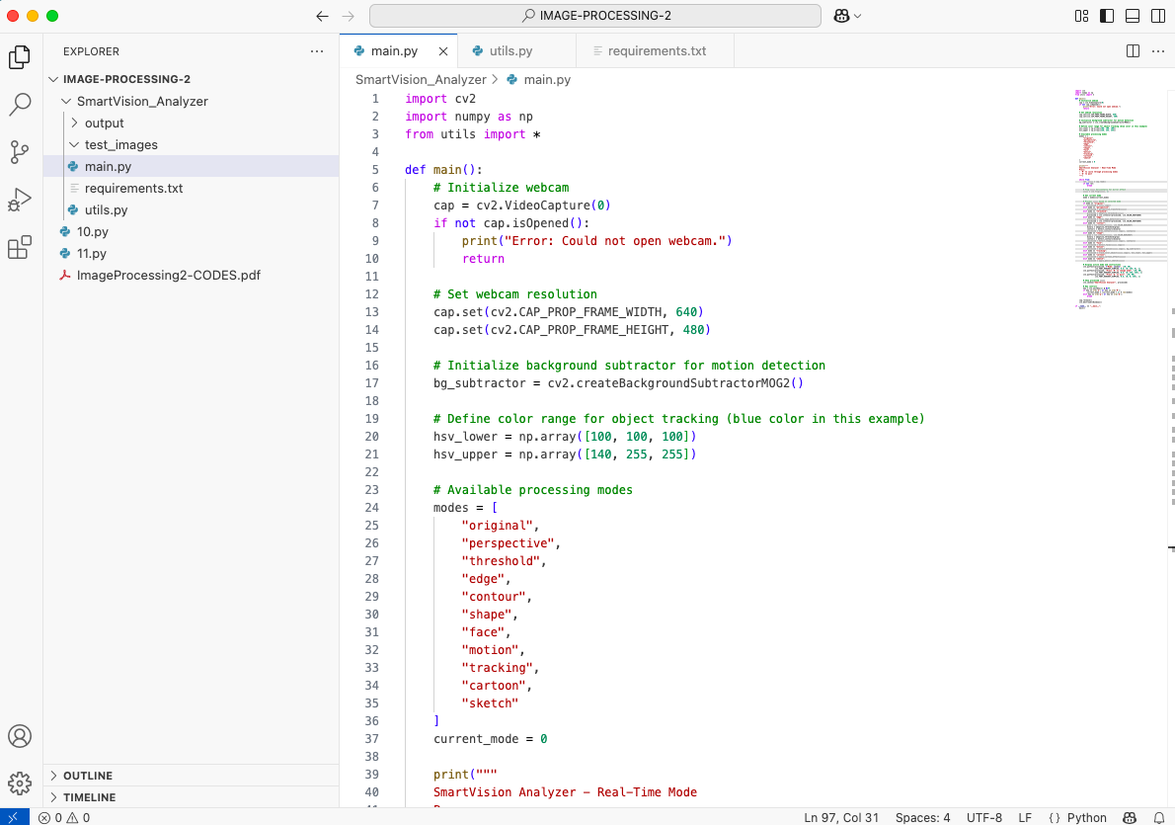

Slide 15
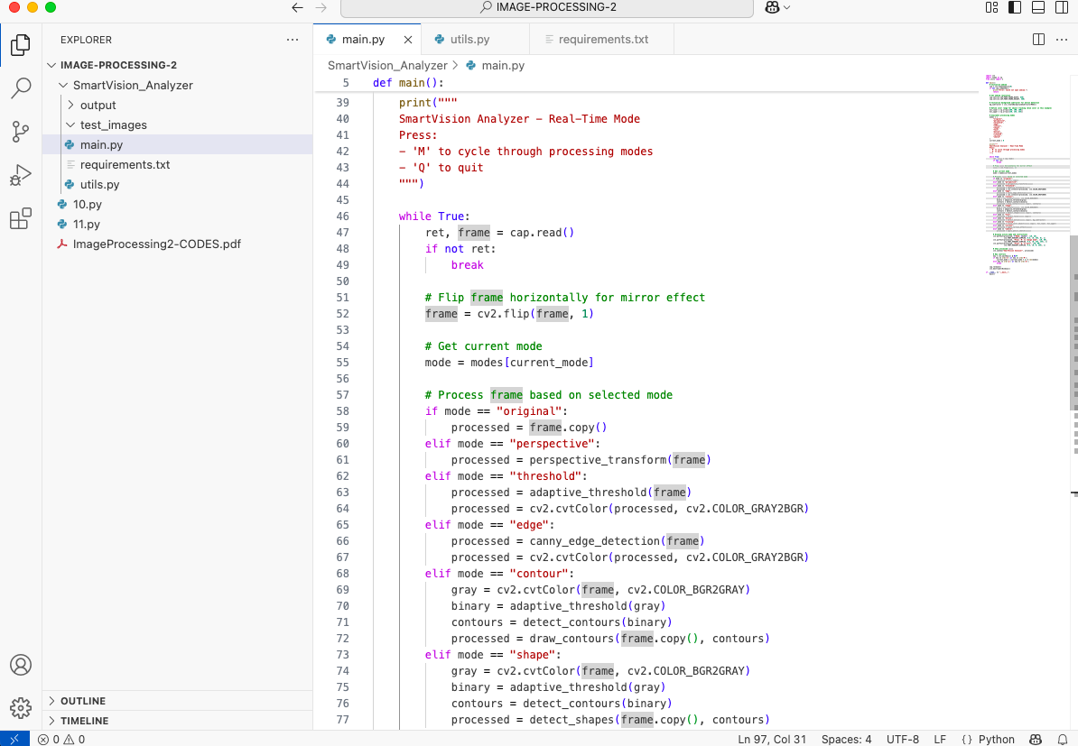

Slide 16
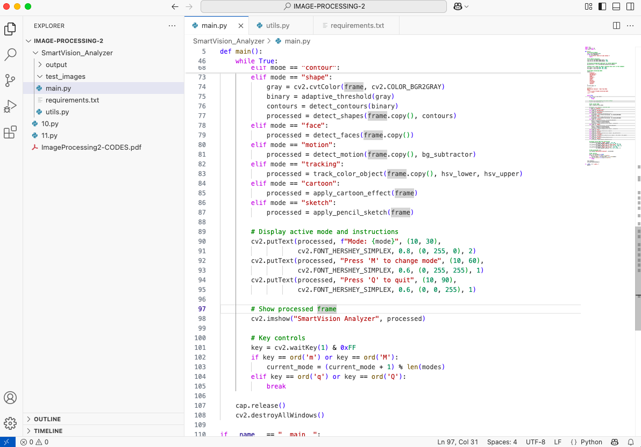
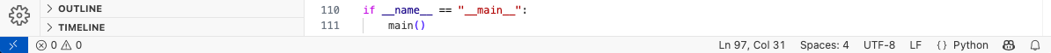

Slide 17
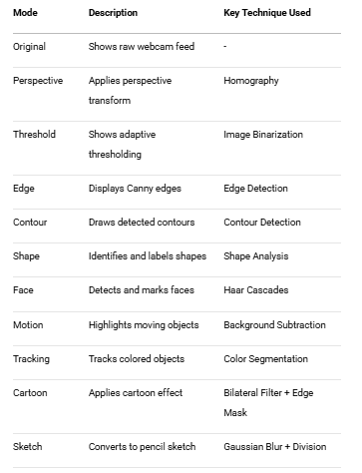
Features Overview

Slide 18
How to Run the Project?
Install dependencies:
pip install opencv-python numpy matplotlib
Run the application:
python main.py
Controls:
Press 'M' to cycle through different processing modes
Press 'Q' to quit the application

Slide 19
Further Enhancements
✅ Add hand gesture control (e.g., palm detection to change modes) ✅ Save processed frames with a keypress ✅ Integrate object tracking (e.g., track colored objects) ✅ Add audio feedback (e.g., beep when face detected)

